Slide 1
Eve Kit Software Installation
Michael Clayton
December 23, 2024

Slide 2
Contents
For INFORMATION
For DIRECTION
For DECISION
TSP Information
Logistic Information
Procedure
Appendix
X
X
X
X

Slide 3
TSP-J-5014
Eve Kit Software Installation
N/A
N/A
N/A
N/A
No
240
N/A
N/A
N/A
Yes
4.0
No
0.5
N
12/23/2024
Michael Clayton
N/A
Rafael Guillen
N/A
Chris Lewandowski
Converted to the NEW 5080 PPT format

Slide 4
Ryan Bednar
8/28/2024
Michael Clayton
8/28/2024

Slide 5
Technician/s Needed to Perform Test: 1
Location where Test will/can be performed.
Lab/Room 1 - # of Days Required
Hardware Needed
Eve kit
Battery box
External monitor with HDMI and Power
Keyboard
USB Storage Device
Computer interface needed
CANoe
CANape
Vector Hardware Configurator
Vector Hardware Manager
Google Chrome

Slide 6
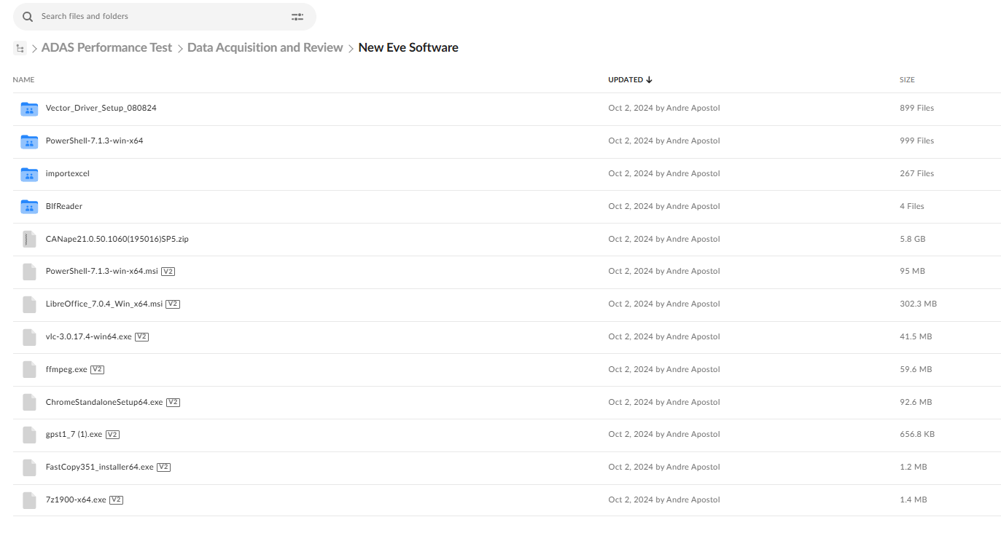
60
Basic Setup
Step | P R O C E D U R E
1 | Contact ADAS team to acquire all the necessary items needed to complete the software installation
2 | Download “New Eve Software” This can be found on Box https://nissan-usa.app.box.com/folder/287207437413?s=onrog3vgklgdjttm8c3rjm1cdx400h1e If you are unable to download the folder, a team member will be able to assist (Photo # 1)
1

Slide 7
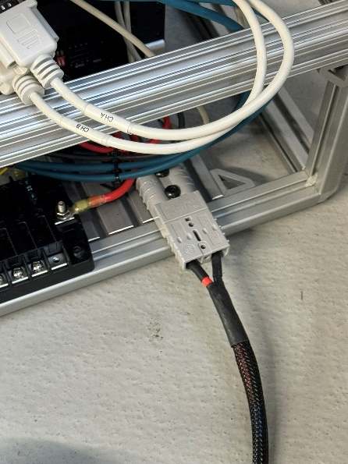
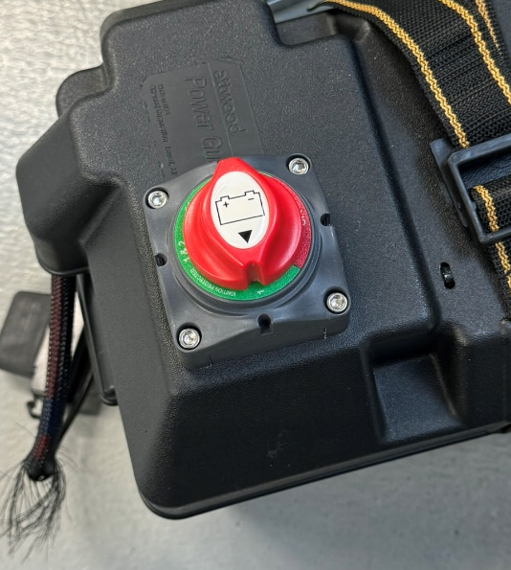
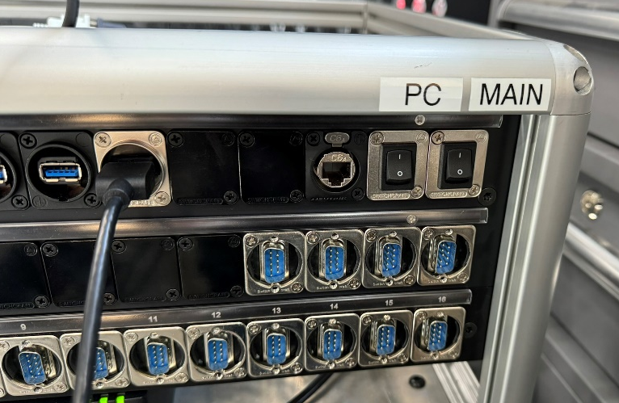
5
Basic Setup
Step | P R O C E D U R E
3 | Plug in battery Anderson connector to Anderson connector on the lower right of the Eve Kit. (Photo # 2) Plug in monitor to HDMI slot on patch panel and any monitor power to USB slot. (Photo # 4) Plug in keyboard and storage device into USB slot on patch panel. (Photo # 4)
4 | Turn battery on. (Photo # 3) Turn Main power rocker on and wait 2-3 seconds. (Photo # 4) Turn PC power rocker on. (Photo # 4)
4
2
3

Slide 8
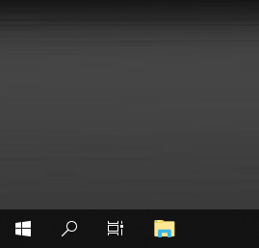
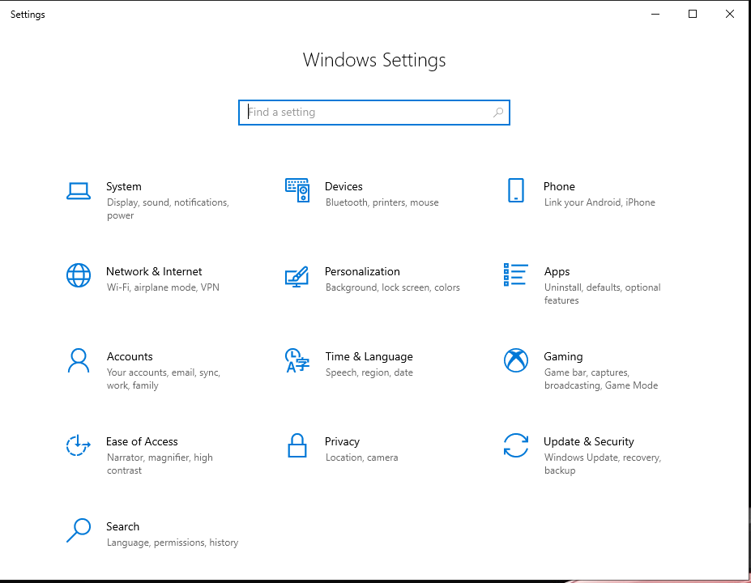
1
Basic Setup
Step | P R O C E D U R E
5 | Search for “File Explorer” right click and choose “Pin to Taskbar” (Photo # 5)
6 | Search for Settings Once in the Settings Window select “Time and Language” (Photo # 6)
5
6

Slide 9
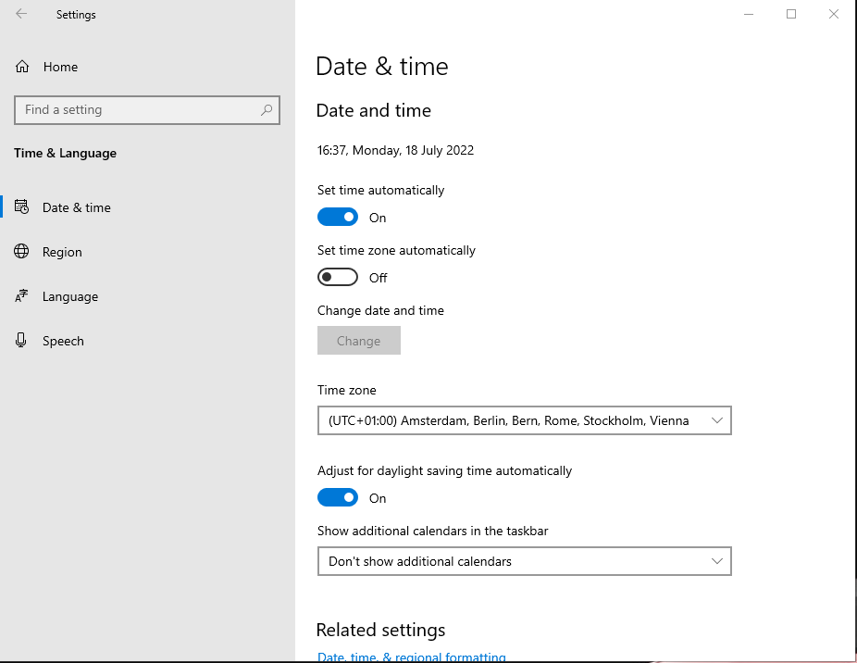
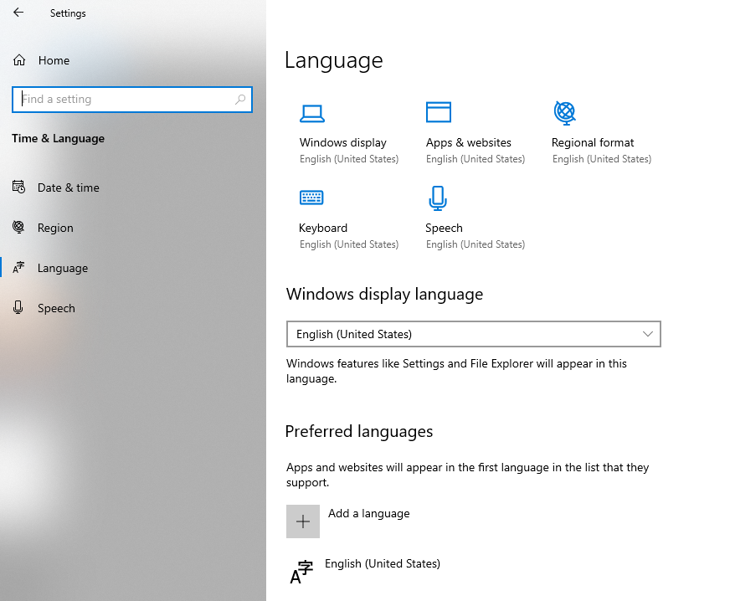
1
Basic Setup
Step | P R O C E D U R E
7 | In the Date & Time Tab, change time Zone to Eastern Time (Photo # 7)
8 | In the Language tab, change Windows, Apps, Regional Format, Keyboard, and Speech to English (Photo # 8) Changes can be made by clicking on the icon and adjusting language in pull down window
7
8

Slide 10

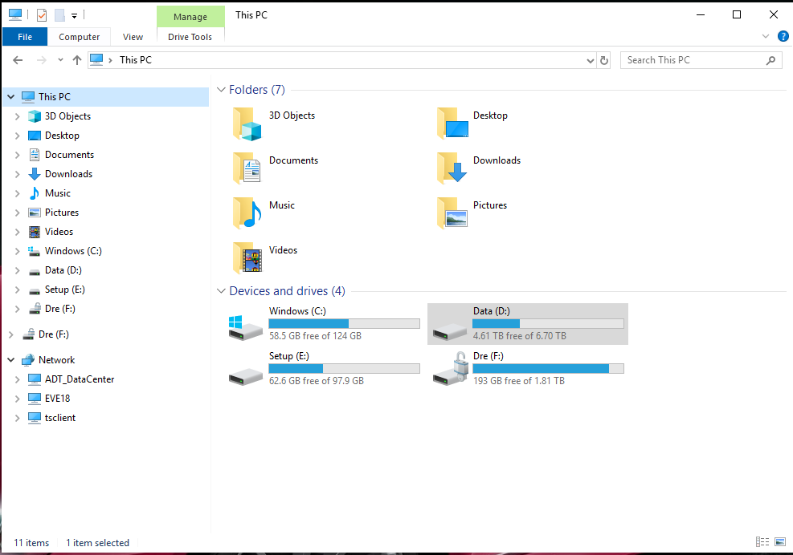
Update Drive Letters and Rename
Andre
Same drive letter setup across ADT FH/SAC/AZ
Change Drive Letters
Previous D Drive -> Change to E Drive
Rename to “Setup”
This drive should have ~100Gb of space
Previous E Drive -> Change to D Drive
Rename to “Data”
Ensure this is the drive with 4+ TB of space

Slide 11
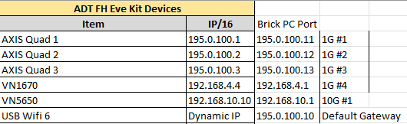
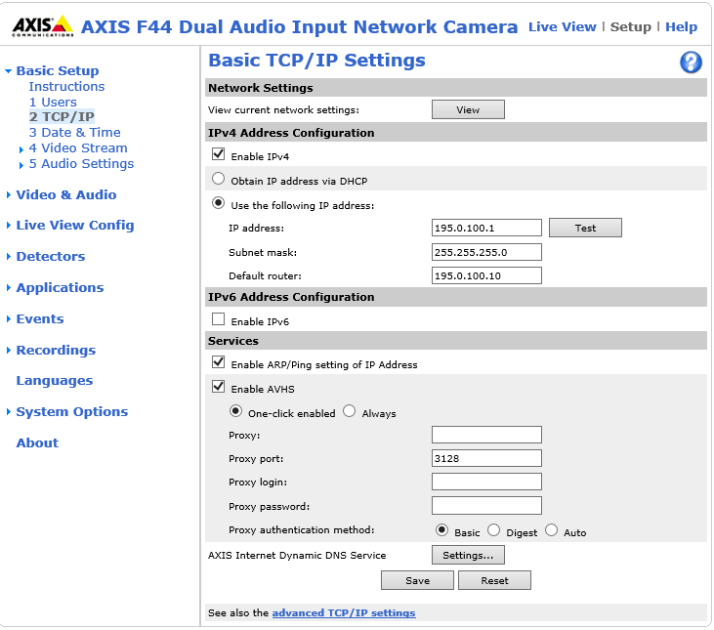
Change Axis Quad IP Addresses
Andre
Same IP setup across ADT FH/SAC/AZ
Axis Quad IP Address Change
Manually change each Axis Quad IP Address in Axis software
Axis Quad 1 -> 195.0.100.1
Axis Quad 2 -> 195.0.100.2
Axis Quad 3 -> 195.0.100.3
Default Router = 195.0.100.10 (Same for all Axis)

Slide 12
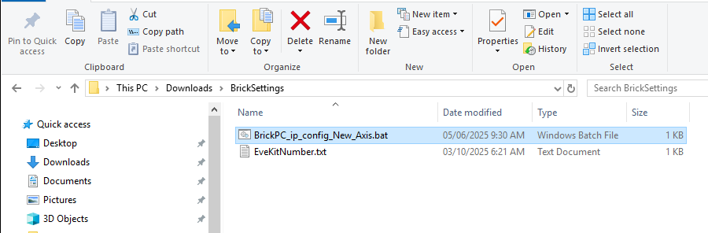
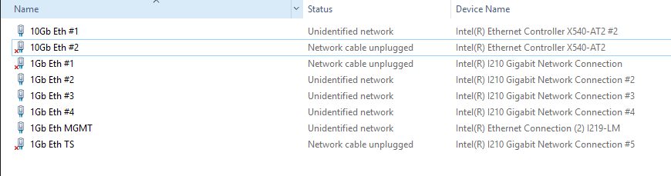
Change Brick PC Port IP Settings
Andre
Same IP setup across ADT FH/SAC/AZ
Batch File Placement
Brick PC Port IP Settings for Axis Cams
Place batch file in Brick Settings Folder
This PC -> Downloads -> Brick Settings
BrickPC_ip_config_New_Axis.bat
Confirm Network names are matching image on right
Right click batch file -> Run As Administrator
Assignments are the following, also shown below
1G #1 -> 195.0.100.11
1G #2 -> 195.0.100.12
1G #3 -> 195.0.100.13
1G #4 -> Same as Previous (192.168.4.1)
10G #1 -> Same As Previous (192.168.10.10)
Required Network Naming

Slide 13
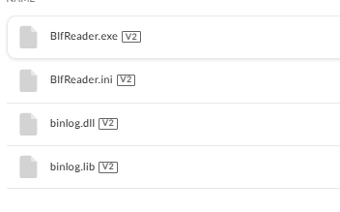
10
Software download
Step | P R O C E D U R E
17 | Transfer the “New Eve Software” from your storage device to the Downloads folder on the Eve Kit.
18 | Open the BlfReader folder and double click on BlfReader.exe file, and it will begin downloading. (Photo # 17)
17

Slide 14
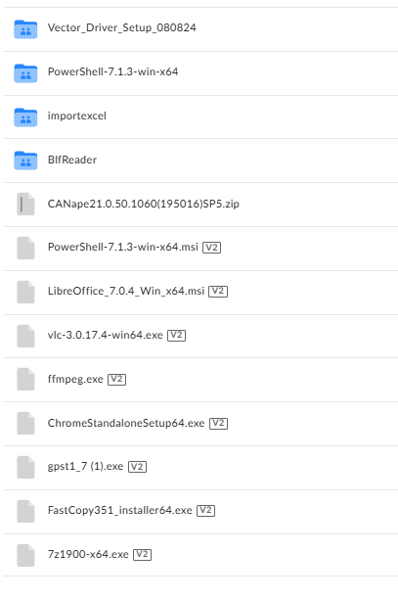
9
Software download
Step | P R O C E D U R E
19 | Repeat step 18 for Powershell-7.1.3-win-x64.msi LibreOffice_7.0.4_Win_x64.mis vlc-3.0.17.4-win64.exe ffmpeg.exe ChromeStandaloneSetup64.exe Gpst1_7 (1).exe FastCopy351_Installer64.exe 7z1900-x64.exe (Photo # 18)
18

Slide 15
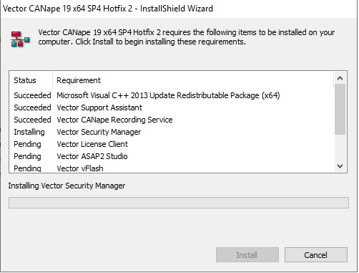
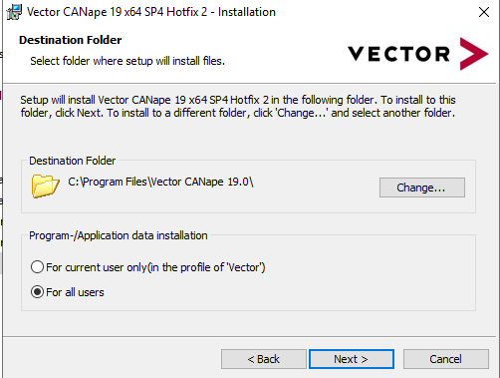
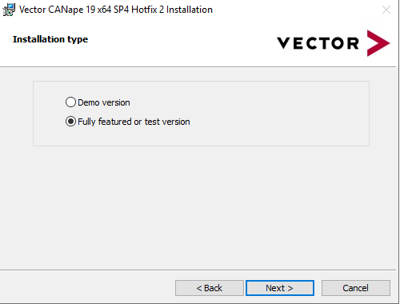
5
Software download
Step | P R O C E D U R E
20 | Unzip and download the CANape21.0 File. Double click Setup.exe to begin install
21 | Install to C:\Program Files\Vector CANape21.0 (Photo # 19) Select the Fully Featured or Test Version (Photo # 20) Note the Eve Kit may restart a couple times during install
21
19
20

Slide 16
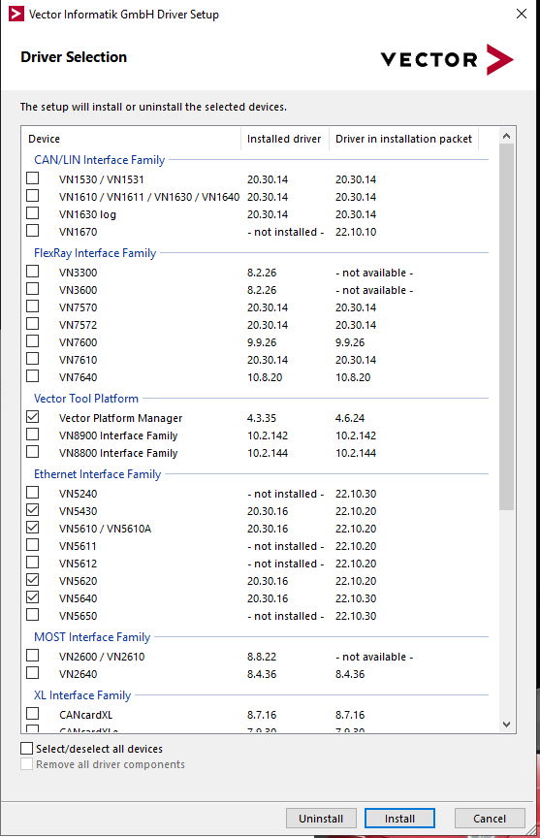
1
Software download
Step | P R O C E D U R E
22 | Vector_Driver_Setup_080824 > Vector_Driver_Setup_24_20_2 > Drivers Double click on setup.exe to download the vector tools
23 | Check the boxes to install the following drivers VN1530/VN1531 VN1610/VN1611/VN1630/VN1640 VN1670 VN5650 Vector Time Sync Service GNSS (Photo # 21)
21

Slide 17
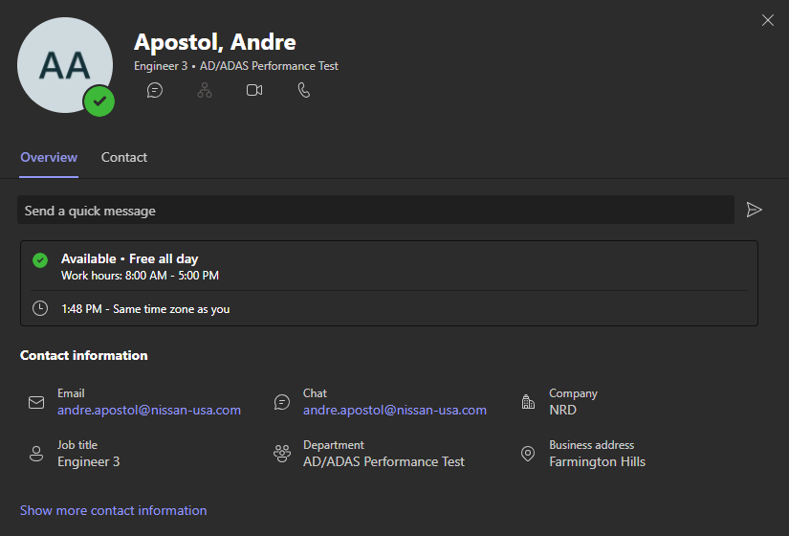
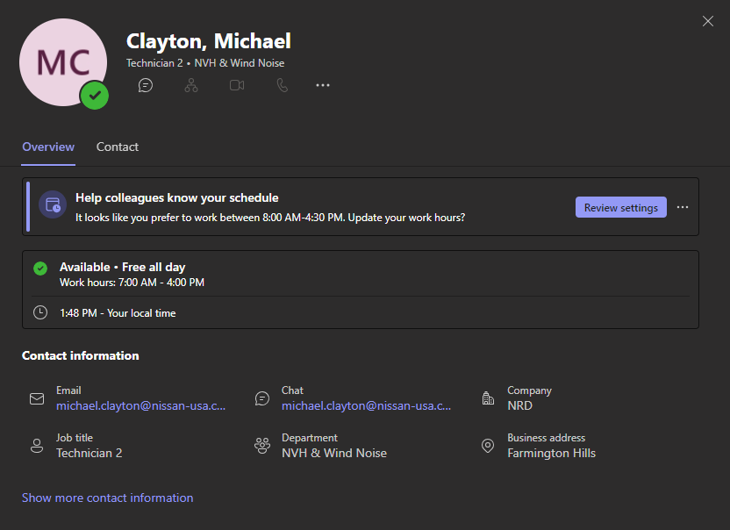
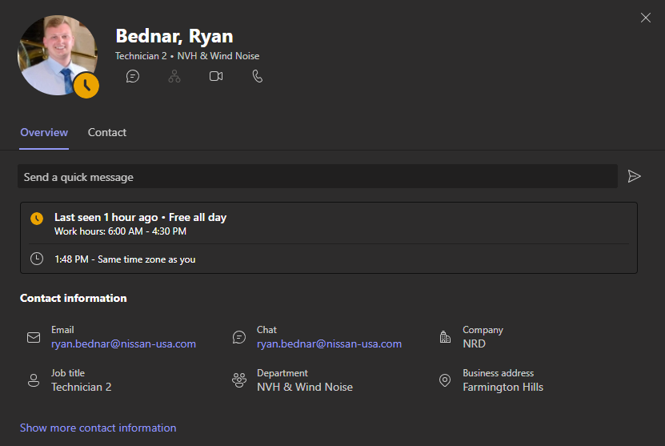
1
Vector License Client
Step | P R O C E D U R E
24 | Work with Andre Apostol, Ryan Bednar, or Michael Clayton to install Vector License to Eve Kit (Photo # 22)
22

Slide 18
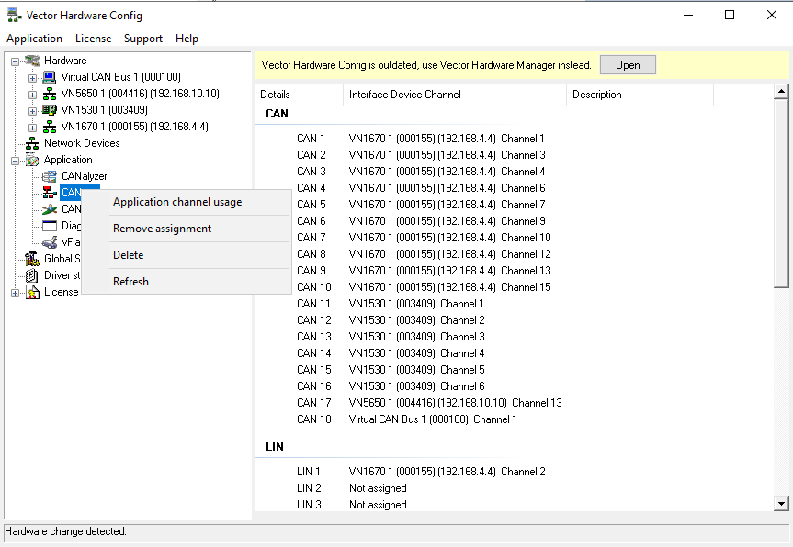
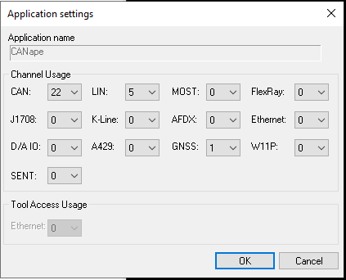
Add to Vector Hardware
Andre
Add CAN21 for OxFord Setup
Open Vector Hardware Configuration
Right click CANape -> Application Channel Usage
Ensure all are 0 except the following:
CAN = 22
LIN = 5
GNSS = 1

Slide 19
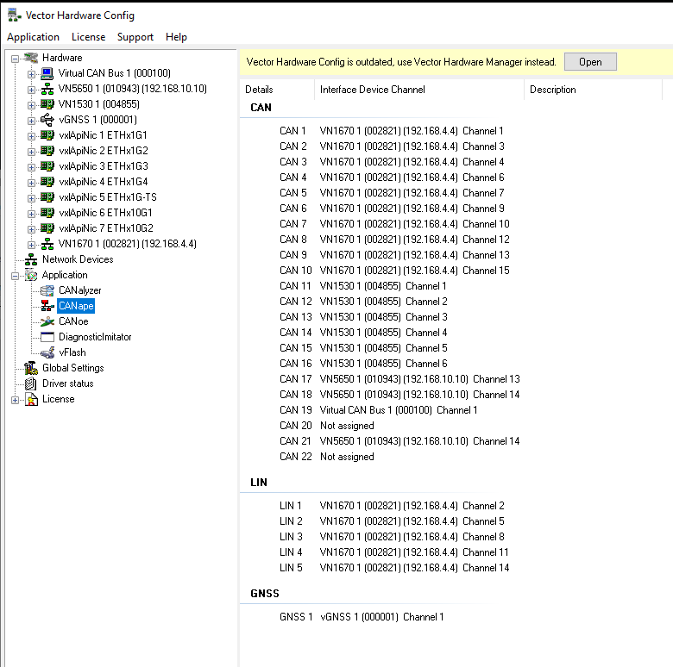
Add CAN21 to Vector Hardware
Andre
Assign CAN18 and CAN21
Verify CAN and LIN
Right click CAN18 -> choose VN5650 CH 14
Right click CAN19 -> choose Virtual CAN Bus 1
Right click CAN21 -> choose VN5650 CH 14
Ensure LIN Channels are accurate
GNSS -> vGNSS Channel 1
Verify Vector Hardware looks exactly the same as image on the right

Slide 20
Upgrade to latest drivers
Andre
For GPS as Vector Hardware Device
Right click CAN18 -> choose VN5650 CH 14
Right click CAN19 -> choose Virtual CAN Bus 1
Right click CAN21 -> choose VN5650 CH 14
Ensure LIN2 is VN1670 CH 5
Do not update Vector Platform Manager?
Confirm latest drivers work

Slide 21
Upgrade to latest version of CANape 21
Andre
CANape 21 SP 6
Right click CAN18 -> choose VN5650 CH 14
Right click CAN19 -> choose Virtual CAN Bus 1
Right click CAN21 -> choose VN5650 CH 14
Ensure LIN2 is VN1670 CH 5
Do not update Vector Platform Manager?
Confirm latest CANape 21 version works

Slide 22
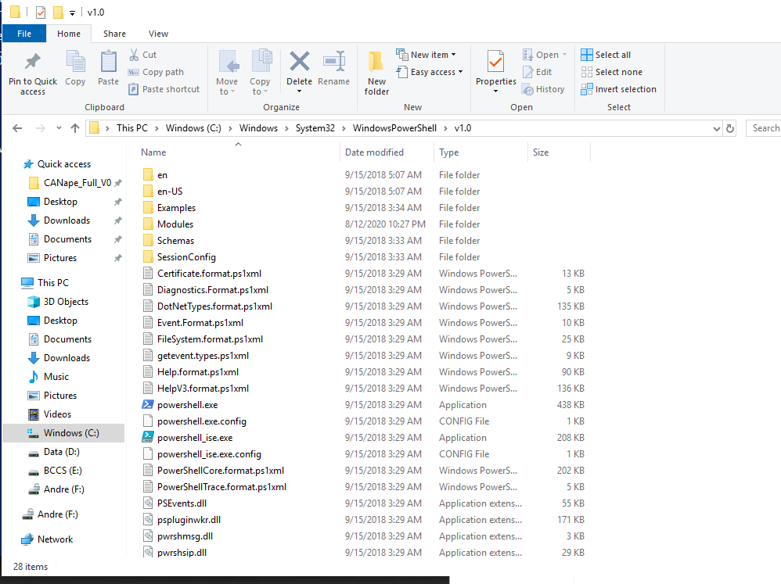
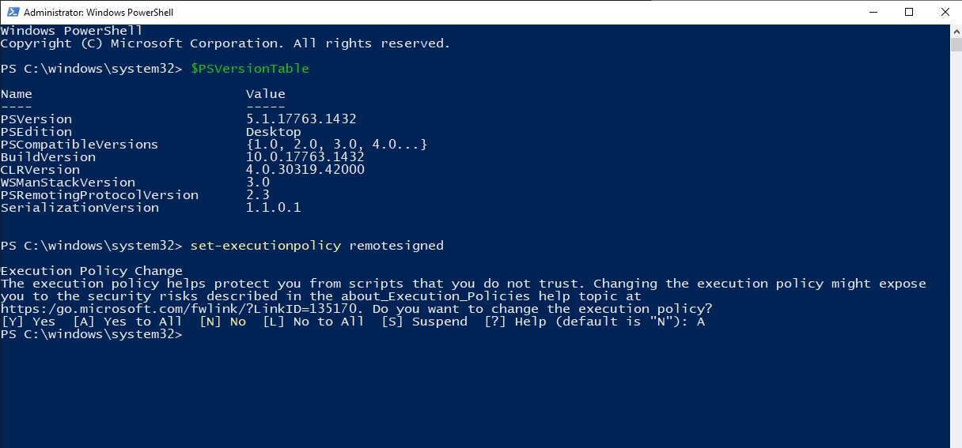
1
Powershell
Step | P R O C E D U R E
38 | Open File Explore folder on task bar
39 | This PC > Windows(C:) > System32 > WindowsPowerShell > v1.0 Scroll down to Powershell.exe, right click and Run and Administrator (Photo # 31)
40 | In the command window (Photo # 32) (1) Type $PSVersionTable *enter* Ensure “PSVersion” = 5.1 (2) Type set-executionpolicy remotesigned *enter* type “A” = Yes to All
1
2
32
31

Slide 23
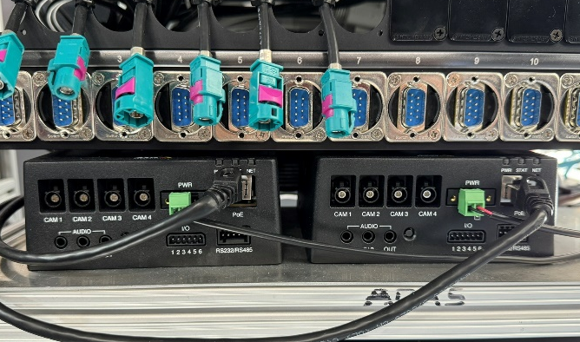
2
Axis Hardware
Step | P R O C E D U R E
41 | Unplug the green power connector from the second Axis Encoder (Photo # 33)
Power connector
33
Encoder #1
Encoder #2

Slide 24
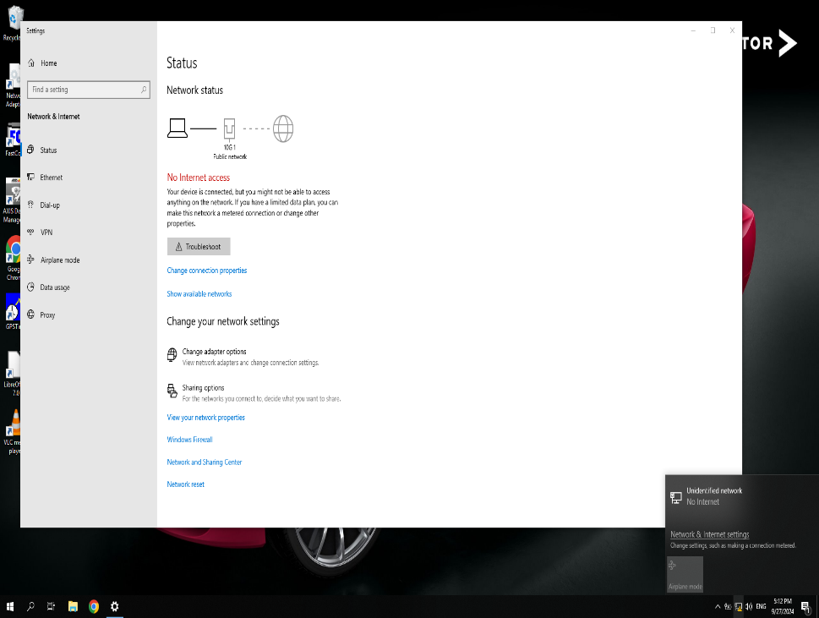
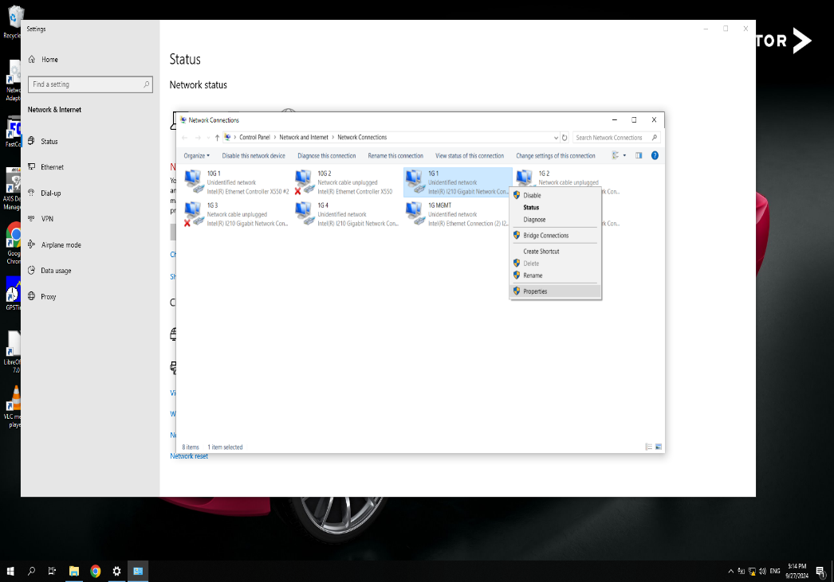
5
Axis Hardware
Step | P R O C E D U R E
42 | Right click on the network icon in the bottom right to go to network settings (1) . Once in network settings, click on “Change adapter options” (2) (Photo # 34)
43 | Right click on the “1G 1” network and go down to properties. (Photo # 35)
2
34
1
35

Slide 25
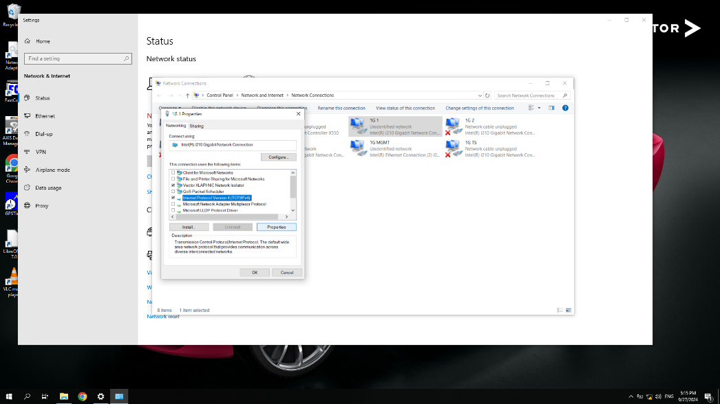
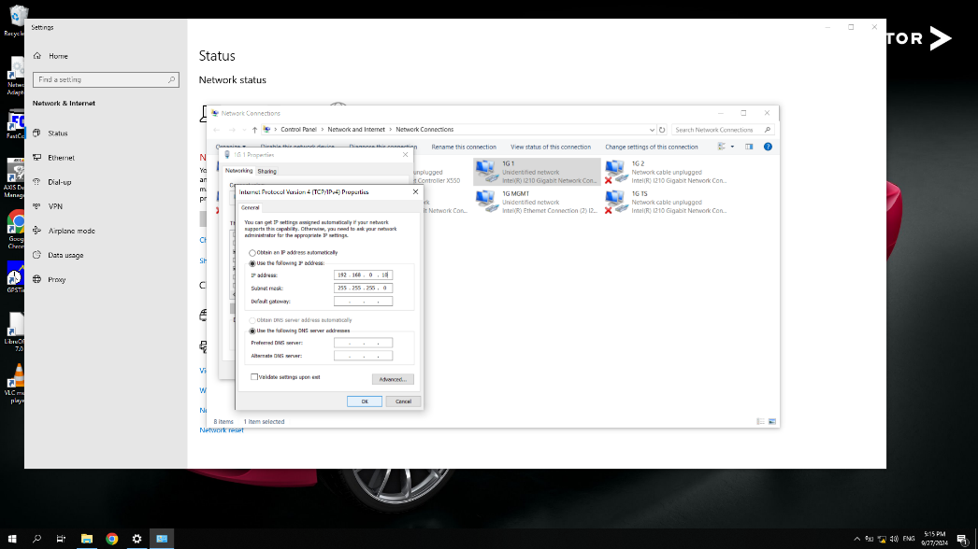
1
Axis Hardware
Step | P R O C E D U R E
44 | Click on “Internet Protocol Version 4 (TCP/IPv4)” then click properties (Photo # 36)
45 | Change the IP Address to 192.168.0.10 and click OK (Photo # 37)
36
37

Slide 26
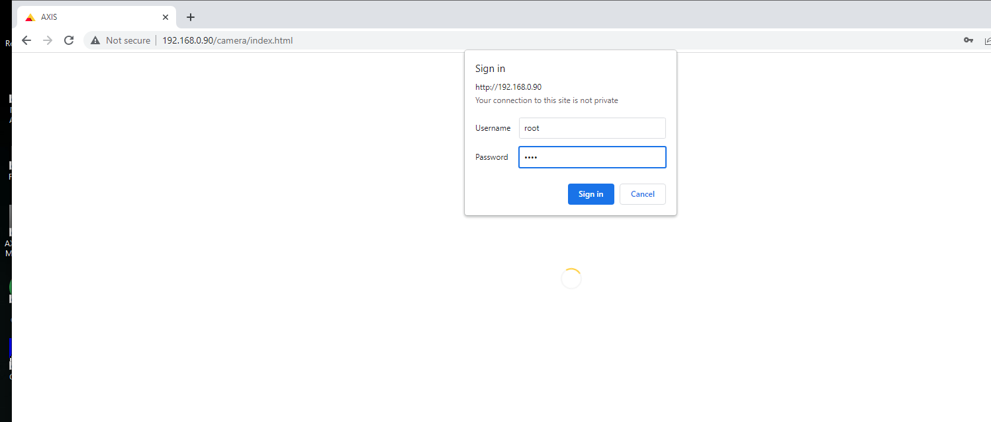
1
Axis Hardware
Step | P R O C E D U R E
46 | Go to google chrome and type in 192.168.0.90 in the search bar, This will take you to the Axis log in page. For Username: root For Password: root You will then be sent back to the sign in page (Photo # 38)
root
38

Slide 27
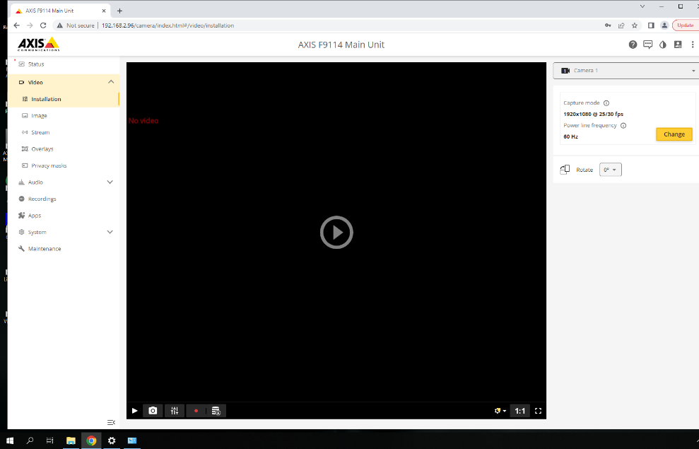
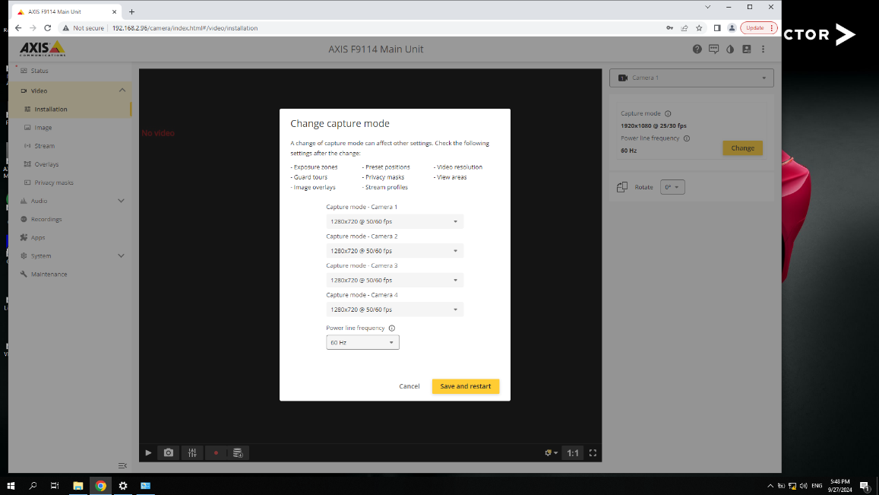
5
Axis Hardware
Step | P R O C E D U R E
47 | Click the yellow Change (1) button on the right side to change the video display settings. (Photo # 39)
48 | Change all video settings to 1280x720 @50/60 fps Click Save and restart. This will prompt the Axis Encoder to restart (Photo # 40)
1
39
40

Slide 28
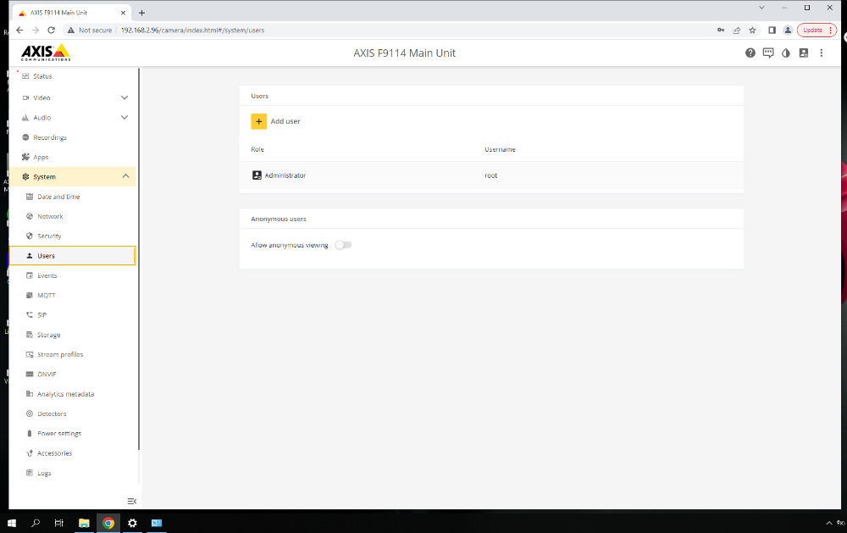
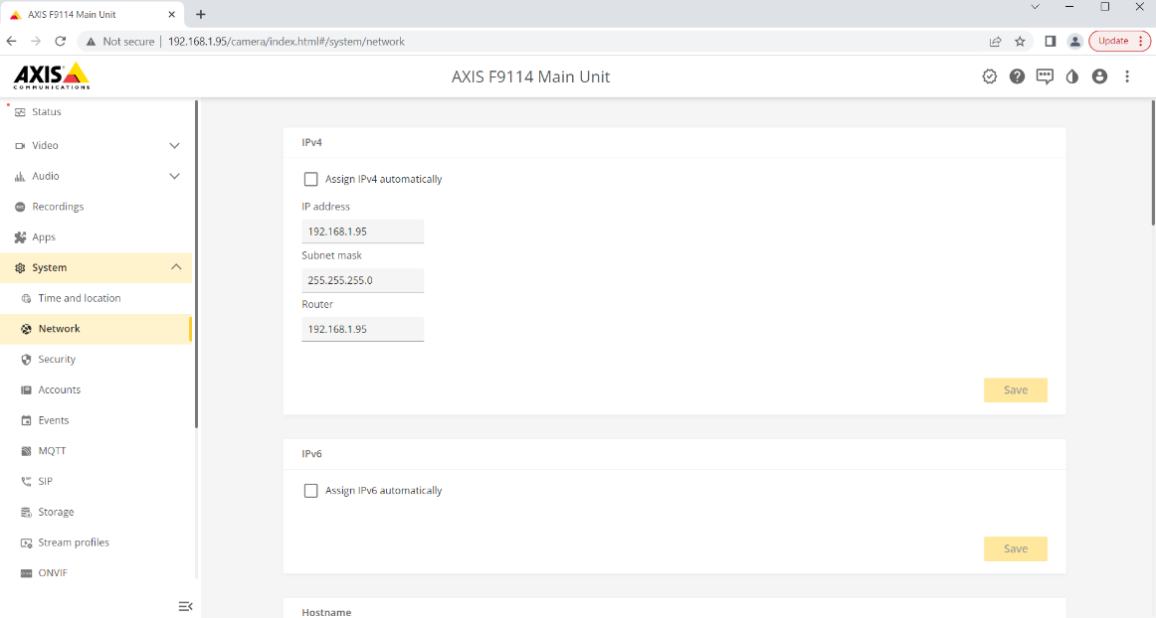
1
Axis Hardware
Step | P R O C E D U R E
49 | Under Systems tab, go to Users and Allow Anonymous Viewing (Photo # 41)
50 | Under Systems tab, go to Network, Uncheck Assign IPv4 Automatically (1) Change the IP Address to 192.168.1.95 and click Save. (Photo # 42)
1
41
42

Slide 29
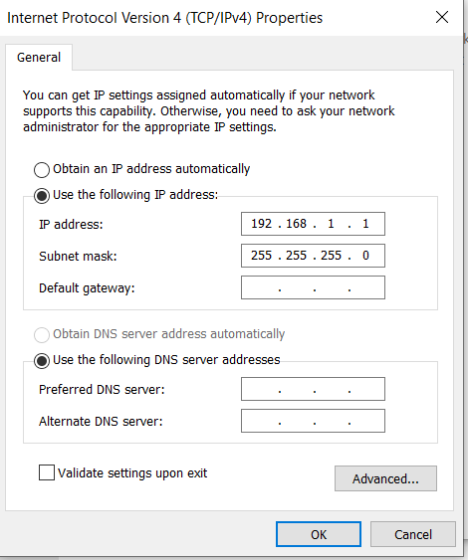
1
Axis Hardware
Step | P R O C E D U R E
51 | Go back to the network adapters for 1G 1, click on “Internet Protocol Version 4 (TCP/IPv4)” then click properties (Photo # 43)
52 | Change the IP Address back to 192.168.1.1 and click OK (Photo # 44)
43
44

Slide 30
5
Axis Hardware
Step | P R O C E D U R E
53 | Unplug the green power connector from the first Axis Encoder and plug power connector in for second Axis Encoder (Photo # 45)
Power connector
45
Encoder #1
Encoder #2

Slide 31
20
Axis Hardware
Step | P R O C E D U R E
54 | Repeat steps 36-45 but for Network 1G 2. - When you reach step 43 the IP address will be 192.168.2.96 - When you reach step 45 the IP address will be 192.168.2.1
55 | If there is a 3rd Axis Encoder; Repeat steps 36-45 but for Network 1G 3. - When you reach step 43 the IP address will be 192.168.3.97 - When you reach step 45 the IP address will be 192.168.3.1
End of Test

Slide 32
Eve Kit AZ Compatibility
Andre
Additional Hardware and Software Eve kit changes
Key Updates for Compatibility
Change Axis Quad IP Addresses
Run batch file to update Brick PC IP Addresses
Update Drive Letters and Rename
Add CAN21 to Vector Hardware for OxFord pluggin
Label CAN18/CAN21 spot on Eve Kit\
Update Vector Drivers to latest (25_10_0)
Update to CANape 21 SP 6 (Final upgrade for CANape 21)
Upgrades for Wifi Data Upload
Remove main USB slot, plug in and mount Wifi 6 Adapter
Update patch panel for one less USB (ensure no confusion or no empty ports)
Setup Synology Drive Client for wifi data upload to NAS

Slide 33
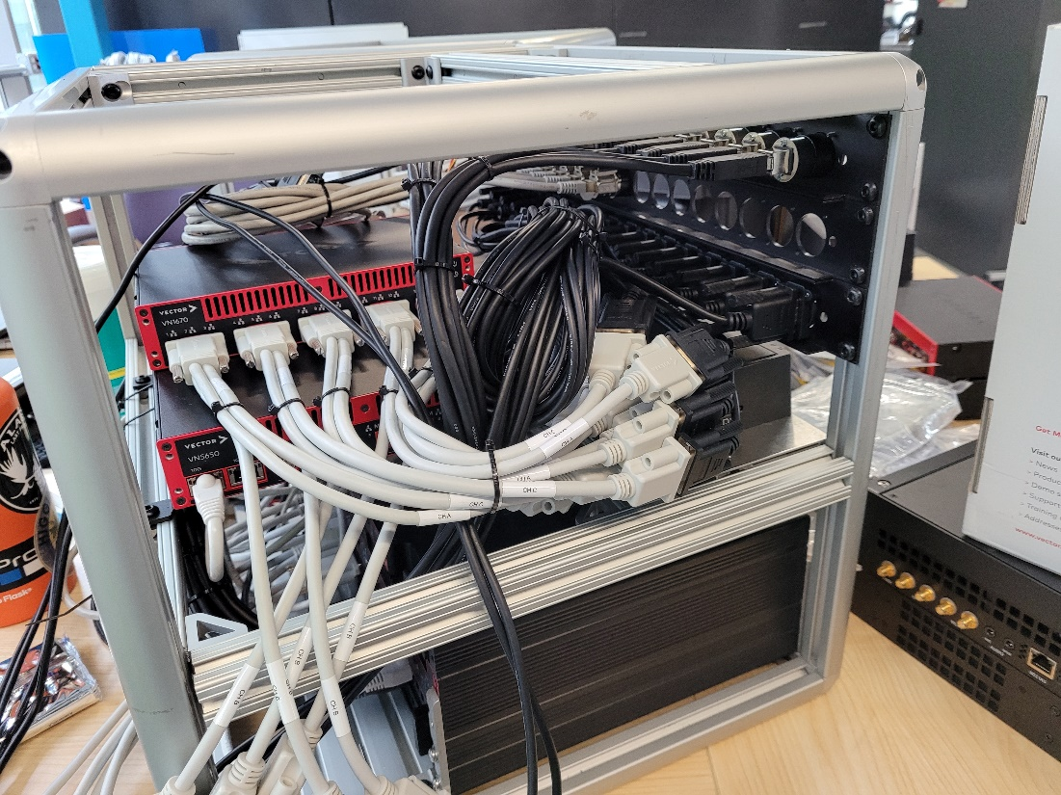
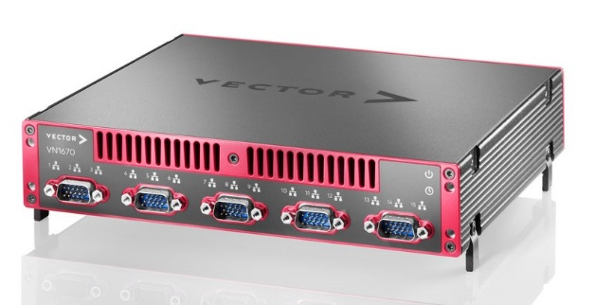
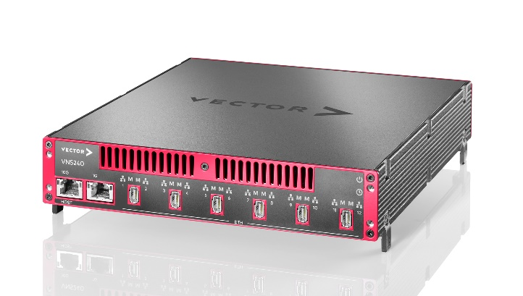
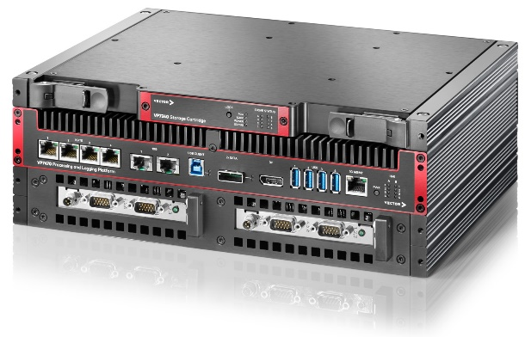
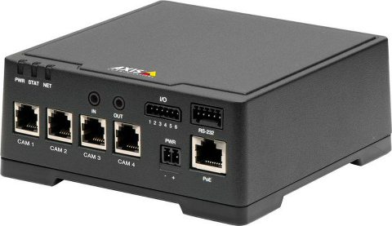
Eve Kit Hardware Detail
Individual hardware components contained in the Eve kit
Main Eve Kit Components
VP7470 – Brick PC with 32 Gb RAM
VN1670 – 10 CAN, 5 LIN
VN5650 – 6 Ethernet, 2 CAN
VN1530 – 6 CAN
Axis F44 (x3) – Up to 4 Axis Cameras
ITS1_FD necessary for online tuning
VN1670
VN5650
VP7470 – Brick PC
F44 Axis Encoder

Slide 34
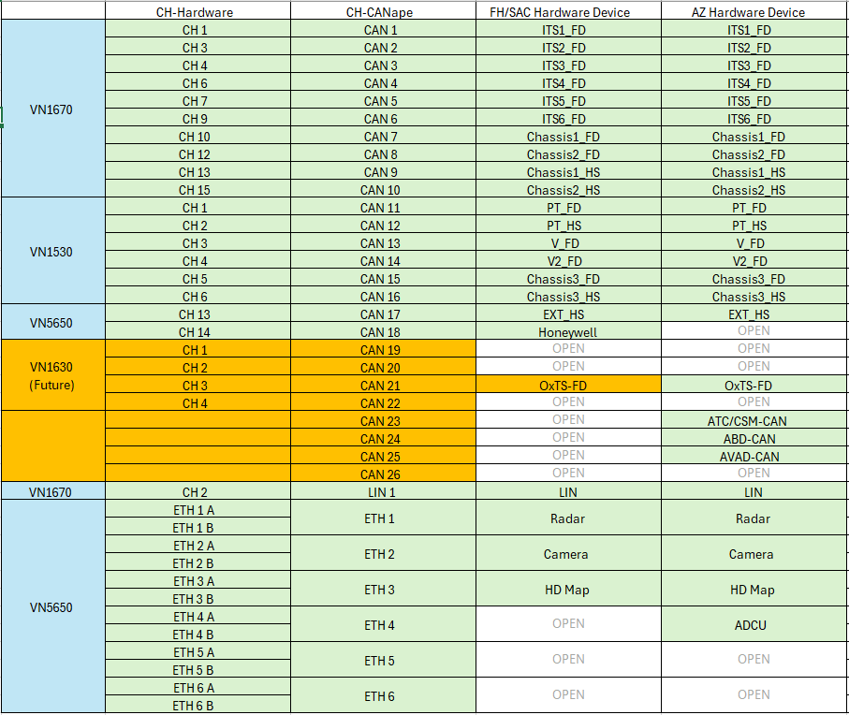
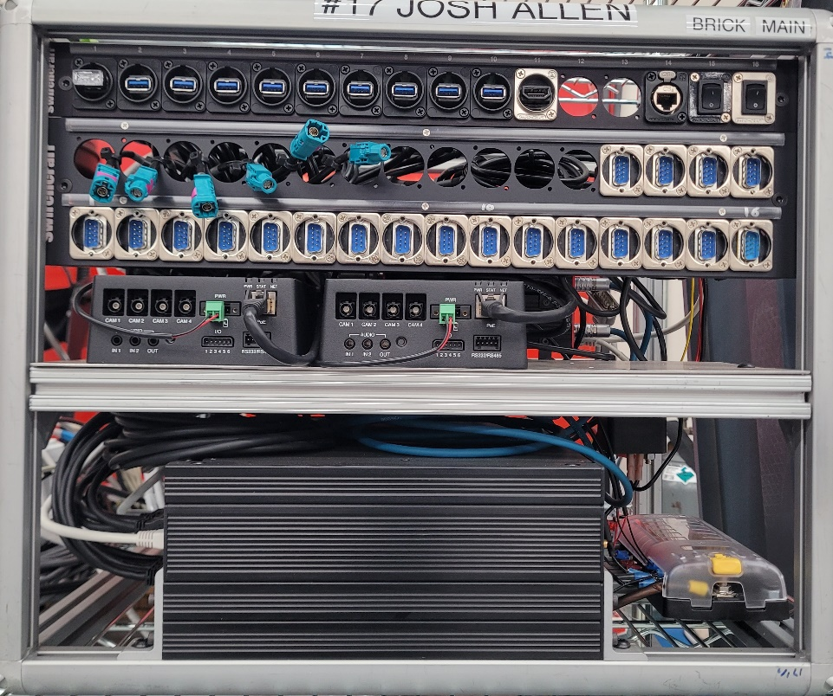
Eve Kit Hardware Setup
Andre
Dedicated hardware CAN assignments for consistency and reliability
Same setup across ADT FH/SAC/AZ
Hardware Setup
Plug in specific CAN device to dedicated port on Eve Kit
ITS1_FD -> CAN1, ITS2_FD -> CAN2, etc
Beneficial to ensure correct database files, recorded signals, and baud rates
Same hardware and patch panel layout across all 23 Eve Systems
Exception, old axis cameras (no risk to new configurations)
CAN 17 - 18, LIN 1 - 2
ETH 1 - 3
CAN 1 - 16
Axis CAM5, CAM6

Slide 35
Wifi Adapter Addition
Andre
Mount Wifi Adapter to Eve Kit
Plug into Brick PC
Mount Wifi Adapter to Eve Kit
Plug USB into Brick PC port 1
Remove patch panel slot for empty USB
Shift HDMI port left 1
Need to put picture of official mounting location

Slide 36
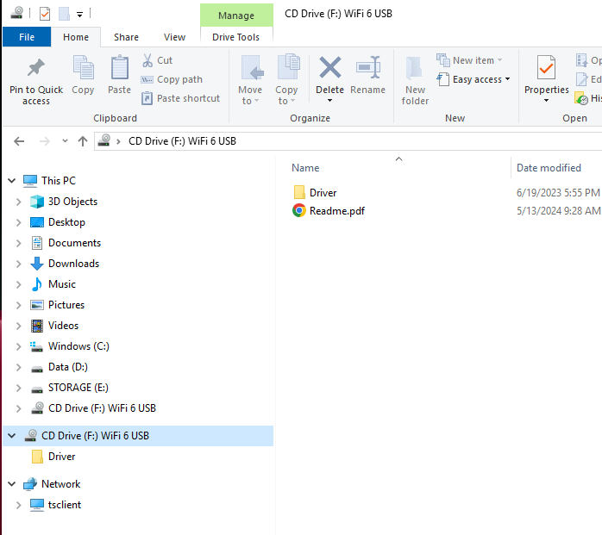
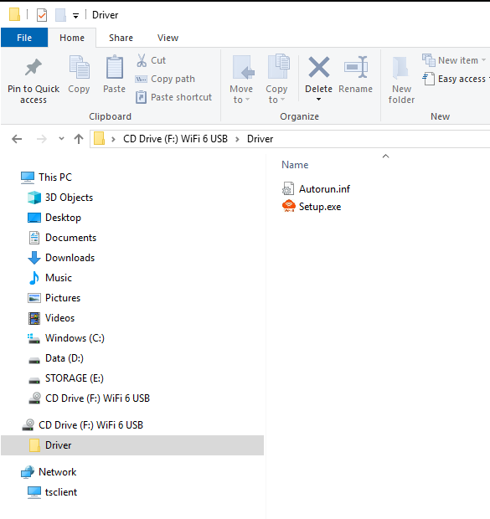
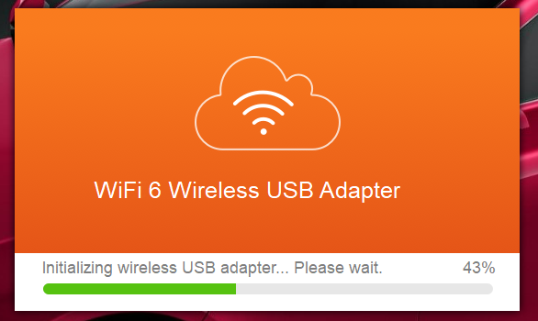
Wifi Data Upload Setup
Andre
Activate Wifi on Brick PC
Open file explorer
Choose CD drive Wifi 6 USB
Choose Driver Folder -> Setup.exe
Installation will begin!
Wait to finish
Will close automatically when complete

Slide 37
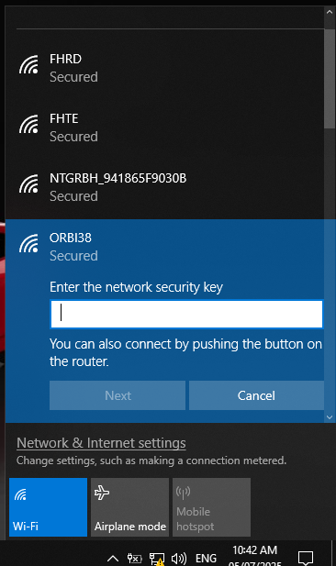
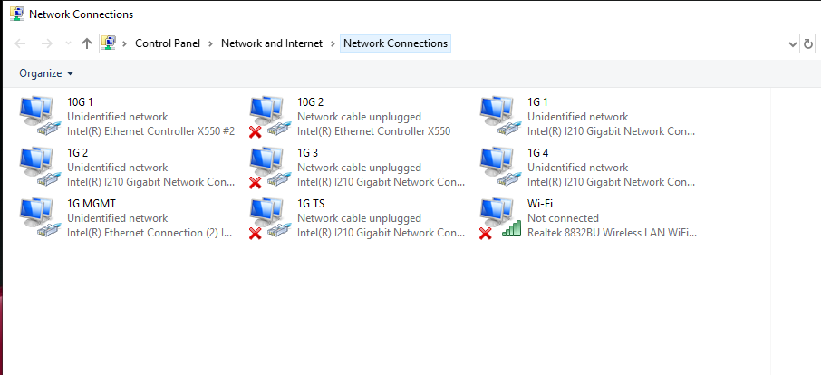

Wifi Data Upload Setup
Andre
Connect to Orbi Router
After Wifi 6 installation is finished, window will close
Network connections will now have wifi option
Open wifi settings and find ORBI38 router
Choose connect automatically
Password = windylake010
Ensure connected successfully! (No internet, secured)

Slide 38

Wifi Data Upload Setup
Andre
Install Synology Drive Client Software
Install Synology Client Software
Software provided by Andre
Click through setup -> very simple

Slide 39


Wifi Data Upload Setup
Andre
Setup Synology Drive Client
Open Synology Drive Client
Connect to NAS
Synology NAS = 195.0.100.101, click search
Choose ADT_DataCenter
Username = ADT_EveUploader
Password = PR0P!L0T
Keep checked “Enable SSL”
Click Next
Choose proceed anyway

Slide 40


Wifi Data Upload Setup
Andre
Setup Synology Drive Client
Choose sync task -> click next
View original folder, edit paths on the next slide
Click change to edit folder to sync from NAS

Slide 41


Wifi Data Upload Setup
Andre
Setup Synology Drive Client
Folder location on computer
Folder to sync from your NAS (195.0.100.101)
Expand team folder
Select CANape_Data
Click OK
Folder location on your computer
Expand D Drive
Select only CANape_Data
Uncheck create an empty “SynologyDrive” folder
Click OK
Folder from NAS

Slide 42


Wifi Data Upload Setup
Andre
Setup Synology Drive Client
Initial folder paths should look exactly like the image on the right
But wait not finished!
Click advanced
Under Folder
Ensure CANape_Data is selected
Every folder below should be auto selected, no need to change
Change to sync mode tab

Slide 43

Wifi Data Upload Setup
Andre
Setup Synology Drive Client
Sync mode tab
Check Upload data to Synology Drive Server Only
Keep checked “locally deleted files”
Keep checked “enable advanced consistency check
Ensure settings match the image on the right -> Click Apply!

Slide 44

Wifi Data Upload Setup
Andre
Setup Synology Drive Client
Ensure file paths are still the same
Enable on demand sync checkbox will be removed automatically -> this is OK
Click done!

Slide 45


Wifi Data Upload Setup
Andre
Setup Synology Drive Client
Click through everything (Next x4)
Ensure the sync task matches the settings on the right
D:\CANape_Data
One-way upload

Slide 46


Wifi Data Upload Setup
Andre
See tasks when data starts to sync
Go to taskbar settings (right click on taskbar -> taskbar settings)
Scroll down -> Select which icons appear on the taskbar
Find Synology Drive Client -> Switch to ON

Slide 47


Wifi Data Upload Setup
Andre
See tasks when data starts to sync
Sync in Progress
Sync Complete
Go to D drive folder
Verify syncing status shows blue icon
Syncing in progress
Green checkmark will show when that folder sync is complete

Slide 48
APPENDIX

Slide 49

CANape Configuration - Setup
Andre
Setup page implemented from AZ configuration
Dedicated CAN assignments from hardware to match CANape software
New Setup page
Input Vehicle Project and Number
Select AD Mode -> Supports data driven tuning
Hardware Match
Check CAN boxes based on connected hardware
Selectable dropdown options for Ethernet channels based on Radar, Camera, and HD map type
Check Axis boxes based on external camera setup
Select commit to automatically enable/disable CANape networks in the Device Configuration
Status of background network displayed with colored LED
Axis camera views are live output
That’s it!

Slide 50


CANape Configuration – Setup Online Tuning
Andre
Additional Steps for Online Tuning Configuration
Online Tuning Additional Setup
Navigate to Device Configuration
Expand Online_Tuning under CAN1
Select database -> Replace A2L file to online tune new vehicle
Different A2L and PDX files for different vehicles
Check page switching
Return to LKA1 Page
Ignition or engine on
Click online
Current LKA parameters will be retrieved from the ADAS module software

Slide 51



CANape Configuration – Confirmation Drive
Andre
Take vehicle for data confirmation drive
Ensure green heartbeats and confirm active GPS triggers
Confirmation Drive
Start recording and drive test vehicle to M5 and back to office
Test of active GPS triggers
Test blue mode capable for AD2 vehicle
Ensure green heartbeats for successful signal recording
Ensure online tuning is working by verifying parameter changes are successful
External Comment Box
Executable built with C# to bypass CANape limitations
Allow for multiple comment boxes open at once
Ensures GPS triggers still successfully cut in the background
Turn comments on and off with convenient switch

Slide 52


CANape Configuration – Automatic Data Cutting
Trigger 1 minute cutout files based on GPS location
New Trigger List Layout
New Trigger List
GPS Trigger Output to Trigger List
Automatic cutting of data when driving through key scenes
Data comparing two runs at the same location can be overlaid and plotted easily
New trigger list structure for data review compatibility
Trigger folder for individual run data
GPS Trigger Scene Name
Free comment for individual trigger

Slide 53


CANape Configuration – Check Data
Andre
Output automatic data check report to confirm reliable data
Output Data Check Report
Return to office, stop recording, allow post processing
Matlab conversion, automatic data transfer to SSD
Navigate to setup page, select Check Data box
Check remaining E Drive space
Script will automatically loop through each folder created from the various recorders
Recorders 1, 2, 3 and Full
Verify output file exists and is an appropriate file size (MF4, BLF, AVI, Trigger List CSV, KML)
Check for important signals in individual MF4 files
Yaw Rate, Steering Angle etc and ensure numerical output
Confirm AXIS Camera videos files
Confirm external SSD is recognized and fast copy is working
See result column to determine success or fail of individual tests

Slide 54



CANape Configuration Setup - Additional
Andre
Full run MAT conversion to support data driven tuning
Continuous monitoring during driving to ensure no data errors
Full Run MAT Convert
Supports data driven tuning to make vehicle models
Automatic CANape function to convert additional data
Continue to add scripts and features that support users automatically for reliable data collection
Avoid manual processing and sorting
Continuous Monitoring
Continuous checking of critical recording issues
Example E drive space
Pop up will show continuously until recording is stopped
Continue to add to this function to ensure no data loss during recording

Slide 55




Data Organization
The Data Center
The Data Center Folder Structure Layout on SSD
CANape Data Organization Overview
The Data Center (CANape Data)
Automatic copy of CANape Data to SSD
Organization by Vehicle Project and Number
Individual Date Folders Created Daily
Trigger folders created for all GPS trigger locations or manual markings
Individual Trigger folders
PAR, BLF, MAT, MF4, AVI
CANape Data Date Folder
Individual Trigger Folder
Trigger Folders

Slide 56


Slide 58
TSP-J-5014
Eve Kit Software Installation

